Slide 1

Course: UNIVERSAL HUMAN VALUES (UHV38) Unit 4: Understanding Harmony in the Nature and Existence

Slide 2
Overview
Understanding the harmony in the Nature
Interconnectedness and mutual fulfillment among the four orders of nature- recyclability and self-regulation in nature
Understanding Existence as Co-existence (Sah-astitva) of mutually interacting units in all-pervasive space
Holistic perception of harmony at all levels of existence

Slide 3
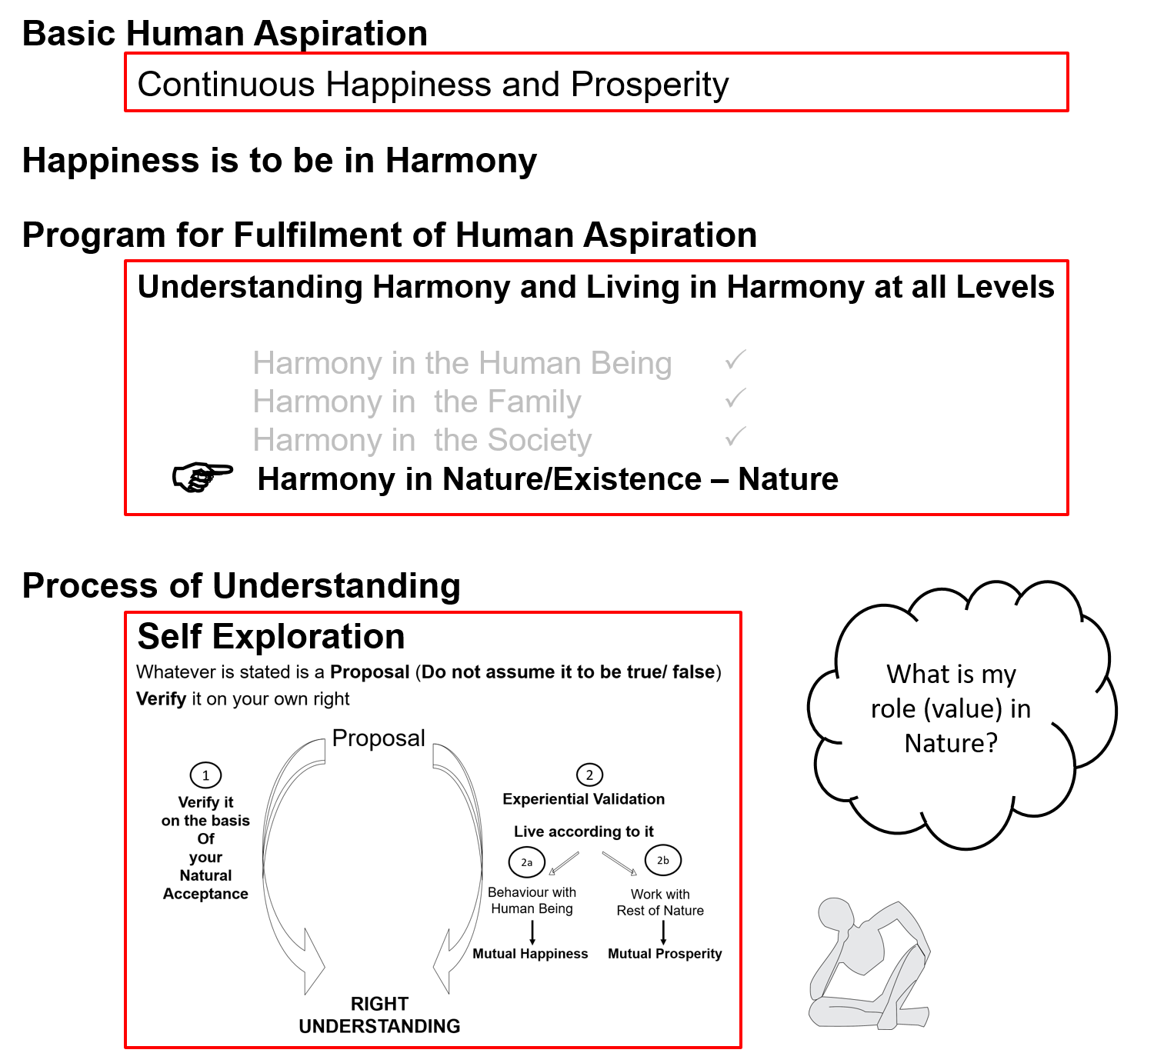

Slide 4
Understanding the harmony in the Nature
If one is to enjoy the benefit of life to the fullest, it is necessary to develop and maintain harmony. The law of nature has a unique cause and effect system which must be understood in order to be in harmony with the natural law of things. Natural harmony is necessary for the following reasons:
To solve the problem of global warming and depletion of non-renewable natural resource can be avoided.
2. With trees cure all problems like – reduction of wind velocity, energy savings, doing companion planting, development of an eco-subsystem in terms of establishing a forest garden, reduction of building heat.
3. One can understand the depths of harmony and alignment in natural by contemplating and reflecting upon the natural order. It is possible to unravel the mystery of the natural synthesis in the midst of ongoing chaos at the material plane.

Slide 5
Understanding the harmony in the Nature
First of all we have to understand the importance of nature for our existence then we have to understand our responsibility towards nature. When we take from nature, we should also plan to give back to it. This is possible. Renewable energy sources, such as solar power and wind, are perhaps the best methods to begin moving in this direction. There can be harmony only if each subsystem of the entire creation can strike a mutually satisfying relationship with every subsystem without disturbing the other’s peaceful existence and without hindering its own growth.
To create harmony in nature, first of all we have to work in the direction of development of mankind from animal consciousness to human consciousness. And this entails working for the right understanding.

Slide 6
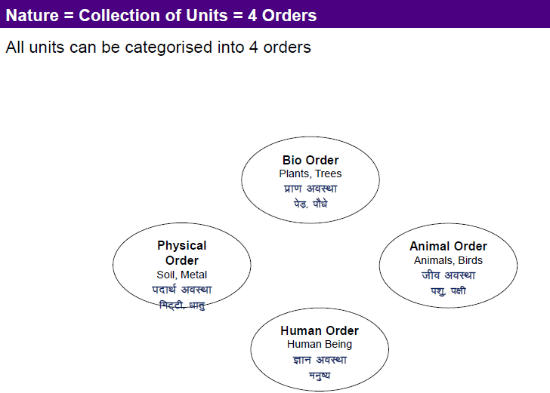

Slide 7
Four orders of Nature
All the physical objects that are in solid, liquid or gas state either living or non living, collectively termed as nature. In other words, the aggregate of all the mutually interacting units – big or small, sentient or insentient together can be called nature. These units are infinite in number and we could easily observe that there exists a dynamic balance, self regulation among all these units. There are four orders of nature:
Material order: The big land mass of the continents, gigantic water bodies like ocean and seas, mountains and rivers, the atmosphere above, the heaps of metals and mineral below, the dense gases and fossil fuels deep below the surface of the earth – all fall into the material order or padartha avastha. In fact, if we look around beyond the earth, the material order is visible even in the form of stars, planets, moons and several astronomical bodies.

Slide 8
Four orders of Nature
Pranic order: Our land mass is covered with grass and small shrubs and they form the lining on the entire soil. Shrubs, plants and trees form huge forest along with the flora in the ocean. All of this is the plant/bio order or prana avastha and it is the next big order on our planet. (The material order is far greater in quantity compared to the plant/bio order)
Animal order: Animals and birds form the third largest order and we call them the animal order or jiva avastha. Here again, we see that the plant/bio order is far greater in quantity than the animal order.
Human order: Human are the smallest order and they are referred to as human order or gyana avastha. Animals are far greater in quantity as compared to the human order.

Slide 9
Four orders of Nature
Pranic order: Our land mass is covered with grass and small shrubs and they form the lining on the entire soil. Shrubs, plants and trees form huge forest along with the flora in the ocean. All of this is the plant/bio order or prana avastha and it is the next big order on our planet. (The material order is far greater in quantity compared to the plant/bio order)
Animal order: Animals and birds form the third largest order and we call them the animal order or jiva avastha. Here again, we see that the plant/bio order is far greater in quantity than the animal order.
Human order: Human are the smallest order and they are referred to as human order or gyana avastha. Animals are far greater in quantity as compared to the human order.

Slide 10
Interconnectedness between Material Order and Plant/Bio-Order
In the nature, all the units are connected to each other and fulfilling each other. Human being is related to all other human beings. On this basis, we have feelings and emotions for everyone. Human being is connected to all the material units in the existence and gets aware of it as he starts exploring it. We can see this interconnectedness and mutual fulfillment in the following diagram:
Material Order and Plant/Bio-Order: The material order provides the nutrients to the plant/bio order in the form of soil, minerals, etc while the plant/ bio order decays and forms more nutrients, thus enriching the soil. The plant/bio order also decays to substances like oil and coal, which are stored deep within the earth as protection against the heat from the molten core inside the earth as well as the heat from the sun(today, this is the material we are removing and using as fuel). Plants help move the nutrients through the various layers of the soil. The roots of the plants hold the soil together and prevent the soil from erosion. Plants produce oxygen/ carbon dioxide and thus help in the movement of the material order. There is a mutual interdependency and co-existence we can see here.

Slide 11
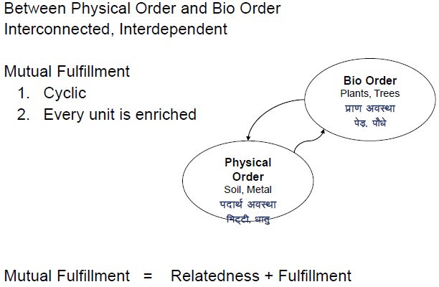
Interconnectedness and mutual fulfillment among the four orders of nature

Slide 12
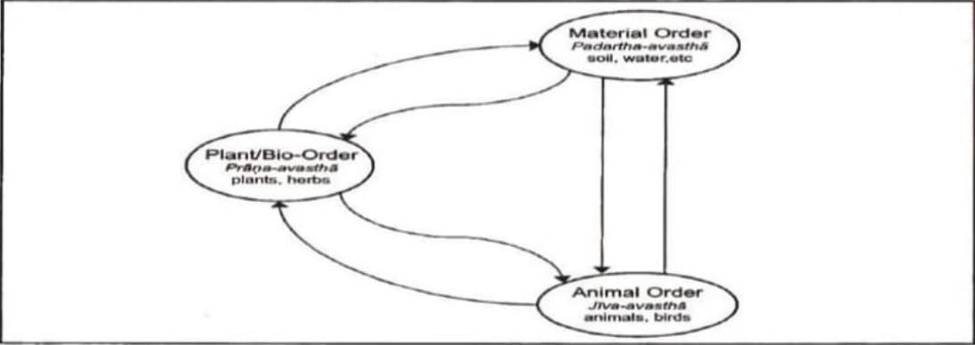
Interconnectedness between Material Order , Plant/Bio-Order and animal order:
The material order provides the basis for movement of all animals, birds and fishes. Water, oxygen and other gases are necessities for both plants and animals. At the same time, the animal order helps enrich the soil with its excreta and this excreta helps the plants with nutrients. The plant/bio order provides food for animals, birds and fishes. The animal Order helps in pollination of the flowers of the pranic order.

Slide 13
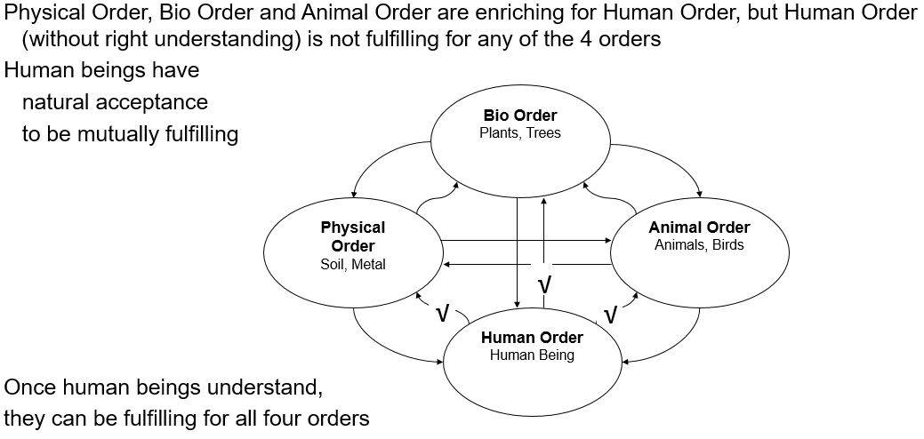
Interconnectedness between Material Order , Plant/Bio-Order , Animal order and Human order:

Slide 14
Interconnectedness between Material Order , Plant/Bio-Order , Animal order and Human order:
We humans also have a natural acceptance to be mutually fulfilling to these three orders. However, we are not able to ensure this mutual fulfillment.
We are dependent on the material order for soil and minerals and metals, but only end up polluting the soil and depleting the fossil fuels;
We are dependent on plants for our food and holding together the larger ecosystem, but we have destroyed forests and destroyed multiple species of plants and herbs;
We are dependent on animals to carry out our production and transportation activities, but have made many species of animals extinct, and are today known for our cruelty towards animals.
We can see that there is interconnectedness and mutual fulfillment in all the orders of nature except human order. We have to work on this.

Slide 15
Meaning of Innateness (dharana):
Innateness means qualities which are innate to the unit. Each unit in existence exhibits an innateness, an intrinsic quality that cannot be separated from it. We refer this principle as innateness also called dharana of that unit. This is intrinsic to the unit.
Innateness of Material order, plant order, animal order and Human order:
Material order: When we burn coal and it has finished burning and only some ash is left and smokes have gone out, it is not that the basic material, the fundamental particles in coal, have ‘cease to exist’ or ‘disappeared’ from existence. They may not be visible to the eye at that moment, but they continue to exist, they still are in the form of other matter or in the form of gases, etc. This is there with all material units. We cannot destroy matter, we can only convert it from one form to the other. Thus, “to exist”, or ‘existence’ is intrinsic to all material, it is innate to it. We cannot separate the ‘existence’ of a thing from the thing itself.

Slide 16
Innateness of Material order, plant order, animal order and Human order:
Plant/bio order: Because the pranic order is a development of the material order, it also has the innateness of ‘existence’. In addition, it also exhibits the ‘growth’. This principle of ‘growth’ cannot be separated from any units of this order. If it is of pranic order, it will grow. For example, if you have a plant, you cannot stop it from growing. It will continue to respire and keep changing in this way. The only way you can stop it from growing is by cutting it, but when you do that, it ceases to belong to the pranic order, instead decays and then belongs to the material order. So, as long as you have a plant, it will grow.
Animal order: The animal body is a development of the pranic order and therfore this order inherits the innateness of the previous order namely ‘existence’ and ‘growth’. This is at the level of the body, which is physico-chemical in nature. In addition, all units in this order have the ‘will to live’ in ‘I’. Indeed no unit in this order can be separated from this ‘will to live’. It is intrinsic to every unit in this order.

Slide 17
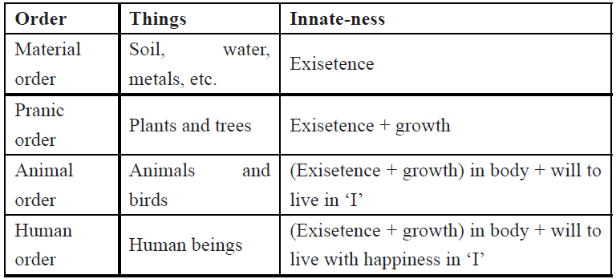
Innateness of Material order, plant order, animal order and Human order:
Human (knowledge) order When we look at the human being, we find that ‘existence’ and ‘growth’ are fundamentally present in the body, just as in the animal body. At the level of ‘I’ however, in addition to the ‘will to live’, a human being’s innateness is the ‘will to live with happiness’.

Slide 18
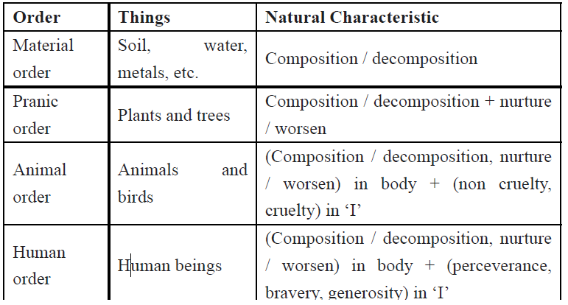
Natural Characteristics of Material order, plant order, animal order and Human order:
When we look at the different orders in nature, we find that each order has a certain value. In a fundamental way, this is the ‘usefulness’ or ‘participation’ of the order in existence. This ‘value’ or ‘participation’ is also referred to as “natural characteristic”. The ‘characteristic’ the order displays in ‘natural to itself’. This is the same as the value of the entity, or its participation also called ‘svabhava’.

Slide 19
Perseverance, Bravery and Generosity characteristic of human beings:
The svabhava/ value oft he self (‘I’) in human beings is perseverance (dhirata), bravery (virata)and generosity (udarata).
Perseverance (dhirata): Being assured that the all encompassing solution is to understand and live in harmony at all levels of existence, living with this commitment without any perturbation.
Bravery (virata): Being assured that the all encompassing solution is to understand and live in harmony at all levels and I am ready to help the other to have the right understanding. This is the commitment to help the other have the right understanding of the harmony and living at all levels of existence.
Generosity (udarata): Being assured that the all encompassing solution is to understand and live in harmony at all the four levels and I am ready to invest myself, my body and wealth to help the other have the right understanding.

Slide 20
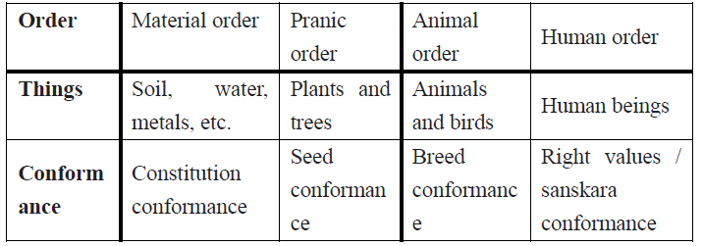
Meaning of Conformance & conformance in 4 orders:
Each unit conforms through the principle of conformance or anusangita. It means how the continuity of the fundamental nature of the unit is preserved.
Material order The continuity of the fundamental nature of the material unit is preserved through the physical and chemical processes. Take iron for example. Each atom of iron conforms to the constitutional structure of ‘Iron’. There is no atom of iron that will be unlike the other atom of iron, if it were, we would not call it iron. We call this ‘constitution conformance’. The material order exhibits constitution conformance. We can verify this for all things in the material order. For example, oxygen, nitrogen, other gasses, gold, silver, aluminium… all of them conform to and are always according to the constitution of their kind. Hence, we say that any matter conforms to its constitution or has ‘constitution conformance’.

Slide 21
Conformance in 4 orders:
Plant/bio order: A neem seed will always sprout a neem plant. All of us know this. Its fruits, its leaves, the taste of the leaves, the colour of the leaves, all this information, this basic information of every neem plant is stored in the seed. Thus, we say the plant is always as the seed, or we can say, ‘as the seed, thus the plant’. Hence, we say that a plant conforms to the seed, or has ‘seed conformance’. This ‘seed conformance’ method is the mechanism by means of which the continuity of a plant species is maintained in nature/existence.
Animal order: We see that a cow is always like a cow, and a dog is always like a dog. Animals conform to their lineage. How animals are, their behaviour, is according to their lineage they belong to, the lineage they come from. Hence, we say that an animal conforms to its breed,or has ‘breed conformance’. This breed conformance method is the mechanism by means of which the continuity of an animal species is maintained in nature

Slide 22
Conformance in Human orders:
Human (knowledge) order
We can see that we humans are not according to our lineage or race, as in animals. We may pick up something from our parents as we grow up, but we are usually very different in many ways from them.
We humans are according to our imagination; according to our desires, thoughts and selection in ‘I’. the desires, thoughts and selections we have in ‘I’ can come from anywhere. It can come from past memories, it can come from our parents, the environment, the media, anywhere. In the case of humans, we can say ‘as the education, so the human’. We are according to our desires, thoughts and selections. Together, we call these ‘sanskara’. Hence, we say that a human being conforms to his or her sanskar or has ‘sanskaar conformance’.

Slide 23
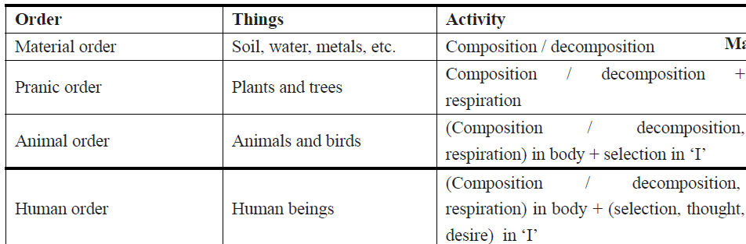
Meaning of Activity & Activity in 4 orders of nature:
Activity: An activity means something that ‘has motion’ and /or ‘has a result’.
The material order is active in multiple ways, and the same with the plant order or animal order or human order. We are sitting in a room. But we are active. We are thinking, desiring, the body has breath running, heart throbbing. The air in the room is blowing. The wall standing constantly also have activity. The chair in the room is also active. It may not be very visible to our eyes but the chair is still active.

Slide 24
Meaning of Activity & Activity in 4 orders of nature:
Material order: All material things (i.e. units in the material order) can be understood as an activity of ‘units’ coming together to form a bigger unit. We call this ‘composition’. For example, the chair is made of smaller pieces of wood. Bigger units can also separate from each other to form smaller units and we call this ‘decomposition’. Like a wooden chair can decay after a few years. Thus any unit in the material order can be understood as an ‘activity of ‘composition/decomposition’.
Plant/bio order : When we look at all the units that make up the plant/bio order we will find that they can be understood in terms of composition/ decomposition and respiration. Not only do plants compose (following new plants) and decompose (decaying), they are also breathing, or pulsating, which we call respiration.

Slide 25
Meaning of Activity & Activity in 4 orders of nature:
Animal order: We can understand the activities of animal order in two aspects:
Body In Animals – Physico-Chemical Activities The body displays the same activities that we see the plant. The body displays respiration, or breathing, or pulsating, as we call it. The body is also formed at one point in time and keeps building cells as well, i.e. there is composition in the body. Hence, the activities in the body are the same as that in the plant/bio order, which are: composition/ decomposition and respiration. Hence, we say that the body belongs to plant/bio order. · ‘I’ In Animals – Conscious Activities The activities in ‘I’ are fundamentally different from those in the body.
Human (knowledge) order :The activities in human body are similar to that in the animal body, and we have seen this in detail as: composition/decomposition and respiration. When it comes to consciousness or ‘I’, however, the human displays more than just an ability to ‘select’ or make choices as animals do.
Thus, in human beings, ‘I’ has the activities of desiring, thinking, and selecting/tasting, with a possibility or need for understanding and realization. Only humans have this need to know and that is why it is called gyana avastha–the knowledge order.

Slide 26
‘Nature is Self Organized and in space Self-Organization Is Available.’
Every unit is an organization. A unit recognizes other units and combines to form a bigger organization. Starting from the atom, to the big galaxy, this organization goes on, as a self-organization. At every level, we get a self-organization. Sub atomic particles recognize each other and come together to form atoms. Cells recognize each other and form organizations like organs and a body. Planetary bodies, solar systems, galaxies are still bigger organizations. We are not organizing it. We are not supplying it organization from outside.
When we look at humans, we see that we are self-organized at the level of the body. We are not organizing the body. We are not doing anything for the coordination between the heart, kidneys, lungs, eyes, brain, hands, legs, etc. All these are functioning together. Our input is needed only to provide the required nutrition, and to assist the body when we fall sick/get injured. At the level of ‘I’, we are not self-organized, but being in space, self-organization is available to the self (‘I’). That’s why we are in pursuit of happiness, which is essentially being in harmony. Whenever we are not in harmony, we are unhappy.
All the units of four orders are self-organized. No one is organizing them from outside. No one is supplying this organization. This self-organization is available to units being in space. Hence, for space, we say ‘self organization is available’.

Slide 27
Self regulation and recyclability in nature
There is interconnectedness and mutual fulfilment among the four orders in nature.
One can also see that there is self-regulation in nature. In a forest, the proportion of soil, plants and animals of various species is self-regulated.
It never happens that the lions eat up all the deer or the deer eat up all the grasses or that the plants grow to the extent that there is no space for deer or that there is lack of soil for new plants and so on.
The forest does not need to be regulated by human being to be in harmony.
With right understanding only, human being will also be self-organised, in harmony within and participate in the harmony in the larger order.

Slide 28
Recyclability and Self regulation in Nature - Examples
There are several cyclical processes that we can see in nature.
For example the cycle of water, evaporating, condensing and precipitating back to water giving the weather phenomena. The cycles keep these materials self-regulated on the earth. Breeds of plants and animals are similarly self-regulated in their environment.
In a forest, the growth of trees takes place in a way so that the amount of soil, plants and animals remains conserved. It never happens that the number of trees shoots up and there is a lack of soil for the trees. The appropriateness of the conditions for growth of both plants and animals are self-regulated in nature keeping the population proportions naturally maintained. This phenomenon is termed as self-regulation.
In a single breed of animals, the number of males and females generated through procreation is such that the continuity of species is ensured by itself. This happens with humans too, but inhuman practices have led to disproportionate numbers of men and women. These two characteristics namely, cyclical nature and self-regulation provide us with some clues of the harmony that is in nature.

Slide 29
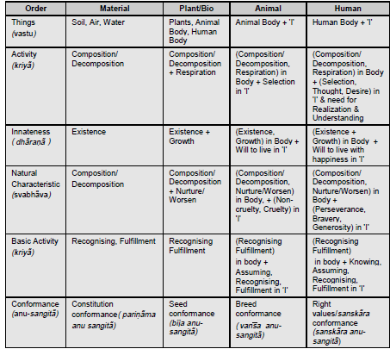
Salient Aspects of Four Orders

Slide 30
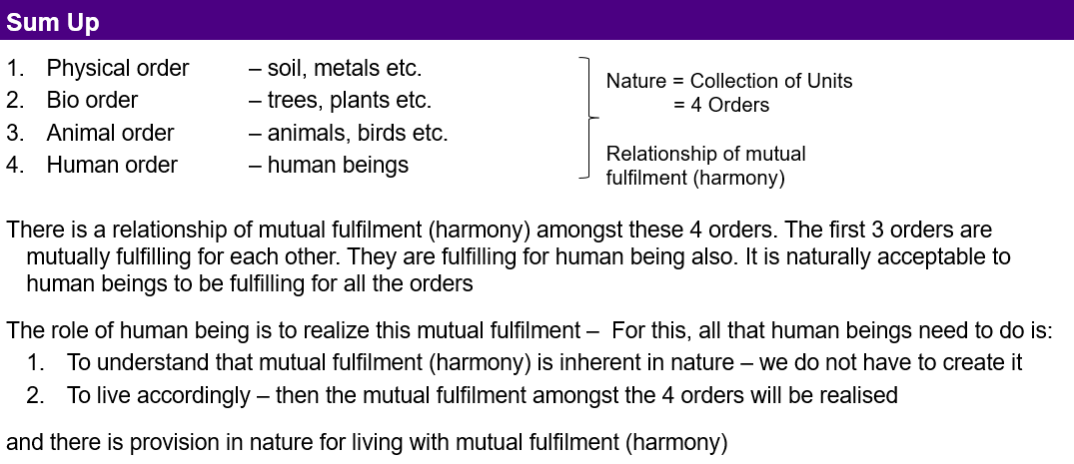

Slide 31
Meaning of Existence, Difference between Unit and Space
All the units together constitute nature. All the units of nature exist in space which is an important reality to understand. Existence is nothing but the nature in space (sunya).
Existence = Exist + Essence, whatever exists.
To be harmony
We define unit as something that is limited in size. Like a small blade of human hair to the biggest planets we know of, they are all limited in size, i.e. bounded on six sides. So, all the ‘things’ we have been studying so far: the human beings, animals, lumps of matter as well as various atoms and molecules, are all ‘units’. We can recognize them as such, they are countable.
But there is another ‘reality’ called ‘space’. We normally don’t pay attention to this ‘reality’, because it’s not a ‘unit’. We can’t ‘touch it’, smell it. We normally just ‘see through it’. But the fact is because we can’t ‘touch it’ or ‘see it’ as we would see a unit like our body, our friends, or a piece of rock, doesn’t mean it does not exist. Space exists everywhere.

Slide 32
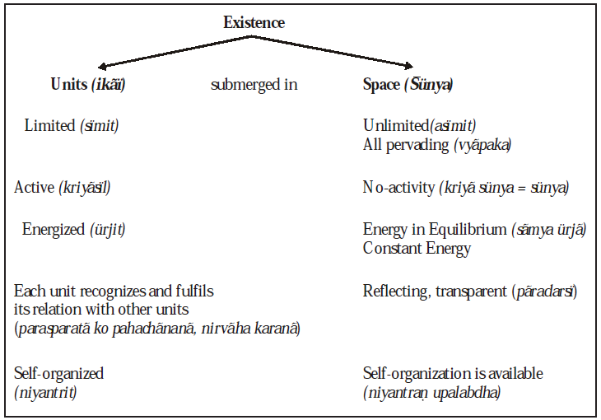
Co Existence Of Units In Space
Co-existence is a state in which two or more groups are living together while respecting their differences and resolving their conflicts non-violently. Co-existence has been defined in numerous ways:
To exist together (in time or space) and to exist in mutual tolerance.
To learn to recognize and live with difference.
To have a relationship between persons or groups in which none of the parties is trying to destroy the other.
To exist together (in time or place) and to exist in mutual tolerance.

Slide 33
Units In Space
When we look at the existence around, the first thing we see is space. And then we see the units in space. Between every two units there is a space. The units exist in space. If we were to define this, we would say that there are two kinds of realities in existence and these are : space and units (in space). So we say,
Existence = space + units (in space).
Since nature consists of the four orders we have been discussing, we can say,
“Existence = Nature submerged in space”.
Nature = Four orders (Material, Plant/Bio or Pranic, Animal and Human Order)
Limited And Unlimited :Nature has four orders and there are units in each order. Each unit is limited in size. The size ranges from being really small (atom) to really big (galaxies). Each and every unit is finite and limited in size, be it the smallest particle or the biggest galaxies. Space, on the other hand is unlimited. Space has no ‘size’, unlike units, it is not bounded. So, there is no beginning or end to space, as there is to units. For example, when you take a book, you know that it starts and finishes. We say the book is ‘limited’ in size. When we take space, there is no such thing. There is space behind us, inside us, between us and the book, between the book and the earth, in the book, in every page of it, inside the page, and beyond the earth…. all the way till we can imagine.

Slide 34
We find that space pervades; it is all-pervading. Units, on the other hand are not all pervading. This is how we recognize them as units.
Active And No-Activity : We can understand each unit as something that is dynamic and active. Be it a physical activity, physico-chemical activity or a sentient activity. Each unit or entity of all the four orders is active. For example : we can our self see that ‘thinking’ is an activity we do, and so is ‘desiring’. Space on the other hand has no activity. Only units are active or in other words, when ‘something’ is active or has activity, we call it a ‘unit’. There is empty space between you and the book right now and it does not have any activity. The particles of gases and dust in between are active, but space is no-activity. That’s how we come to know of it.
Energized And Energy In Equilibrium: What we normally call or consider as energy today, is the ‘transfer of energy’. For example, when you place water in a vessel on the stove, we say the heat energy from the flame was transferred to the water in the vessel. Anything that is a unit, has activity, anything that has activity, is energized. All the particles in the water and the metal stove are active, very active and energized. Hence we don’t say that space is energized but we say ‘space is energy in equilibrium’ or it is ‘constant energy’. All units are energized in space. This energy is available to all units. In other words, space is equilibrium energy, all units are in space; all units are energized and active being in space.

Slide 35
Existence Is Co-Existence:
The existence is ‘units in space’. We studied about space earlier. The units are of two types:
Material (insentient)
Consciousness (the sentient ‘I’)
The material units are transformable, and their composition keeps on changing, hence these are gathansheel. The other category of units, the sentient ‘I’, do not transform and are complete in composition, hence gathanpurna.
The material units are changeful (with activities of recognizing and fulfillment only) while the other kind of units are continuous (with activities of knowing, assuming, recognizing and fulfillment). The material units are available in two orders – material order and pranic order. In the material order, an atom combines with another atom to form a molecule, a molecule similarly forms a molecular structure. Molecular structures are found in two forms: lumps and fluids. Fluids give nutrition to pranic order. In pranic order, the smallest units are plant cells which combine with other cells to form plants, animal bodies and human bodies. The co-existence of ‘I’ with the animal body becomes the animal order, and the co-existence of ‘I’ with the human body becomes the human order. Completion of right understanding in human being is called kriyapurnata and ability to live with complete understanding is called acharanpurnata.

Slide 36
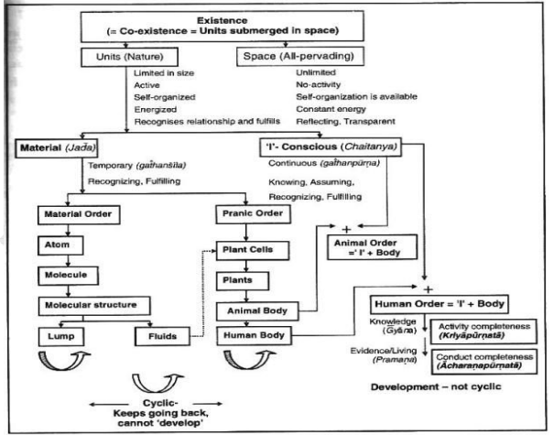

Slide 37
If we look at the left side of the chart, the transformation keeps taking place and the transformation is cyclic in nature. But on the right hand side, the transitions are acyclic. This implies that what we have understood continues to stay with us. We will never miss it. This is a transition in one direction. This is actually called development (vikas).
So, Existence is in the form of co-existence. It is in Harmony. We don’t have to create this harmony, it already exists. We only have to understand it to be in it. This means that having the knowledge of self (‘I’) gives me the knowledge of humane conduct (how to live in existence, with the four orders). With this knowledge, I can live with humane conduct. This is the pending task we have to complete.

Slide 38
Holistic perception of harmony at all levels of existence

Slide 39
Holistic perception of harmony at all levels of existence
Each one of us lives at all these levels-myself, family, society and nature / existence. And wants to understand all these levels of our living.
We will look into ourselves and identify our various activities, our choice, thoughts and desires. This will help us to identify how we think, and what we want.
As a result, human relationship becomes possible if they have right understanding, recognition of values, fulfilment, right evaluation and leads to mutual happiness.
We will also look into the various dimensions of human society, what the comprehensive human goal is and how this can be achieved after that we will study nature existence and understand interconnectedness in nature.
When we have our self-investigation we find out that we want to be in harmony all levels of our living.

Slide 40
Holistic perception of harmony at all levels of existence
Harmony in myself
Harmony in family
Harmony in society
Harmony in nature/ existence.
In harmony in myself, we have mutual happiness and a feeling of prosperity. In harmony in family, we have mutual fulfillment in relationship and prosperity in the family. In society, there is fearlessness and undivided society. In nature, we have harmony in nature and understanding the inherent co-existence.
Having known this harmony at all levels, we can then identify our role in it. This role of human being is nothing but his/ her participation in nature existence. We shall see that these human values are natural and universal.
Thus, this is the holistic way of life.

Slide 41
Existence
(= Co-existence = Units submerged in Space)
Units (Nature)
Space (All-pervading)
Limited in size
Unlimited
This is already in harmony
Activity
No activity
Self-organized
Energized
Recognises the relationship and fulfills
Material tM+
Consciousness (Self) pSrU;
Temporary
Continuous
Recognising, Fulfilling
Knowing, Assuming, Recognising, Fulfilling
Physical Order
Bio Order
+
Animal Order
Atom
Cell
Only this part is remaining
And it has to happen in the Self by the Self
+
Molecule
Plant
Human Order
Molecular Structure
Animal Body
Right Understanding &
Right Feeling
Development
Linear – Not Cyclic
Lump
Fluid
Human Body
No Development
Cyclic
Definite Human Conduct
uf”pr Ekkuoh; vkpj.k

Slide 42
Development in the Existential Sense
Whatever we do with the material world is cyclic.
Only in the human order, there is a potential for development or transformation in the Self which is not cyclic. Development or permanent change is possible only in the domain of consciousness. It is in terms of:
developing right understanding (understanding co-existence) and right feeling (feeling of coexistence) in the Self.
updating all our desires, thoughts and expectations in line with right understanding and right feeling.
Expression in the form of behaviour, work and participation in the larger order.
This development, this transformation in human being is facilitated by education-sanskar. There is every provision in existence for this development.

Slide 43
Development in the Existential Sense

Slide 44
Holistic Technology & Its Importance with Examples
Right understanding helps us to develop a vision of a holistic approach. By holistic approach, we mean the processes and the the technologies adopted by us must be compatible with nature.
Modern technology is the child of human brain. All inventions are the result of increasing needs.
In order to facilitate the development of holistic technologies, it is indispensible to create specific criteria for holistic evaluation of technologies.
The broad criteria to guide the development of such technologies and systems:
Caring to appropriate needs and life style.
People friendly
Eco-friendly.
Modern technologies are creating environmental problems, because of the wide spread use of natural resources. We are burning fossil fuels and other renewable resources. The natural resources are depleting very rapidly. There is now increasing demand through out the world to evolve alternative renewable technologies.

Slide 45
Holistic Technology & Its Importance with Examples
Certainly this is only possible through right understanding and evaluation of human-needs. We need to work on renewable energy technologies.
When we are making use of technology we need to take care of the needs of people. Because the technologies are to help people and this thing needs to be kept in mind, while we evolve a system. In modern days science and technology are not being used only for human welfare and this is happening in the society because of lack of right understanding and an evaluation of human needs.
Instead of making technology, human friendly, we are making it anti-human.
For the right utilization of technology, we need to work out about our basic needs through right understanding.

Slide 46
Thank You

